Slide 1


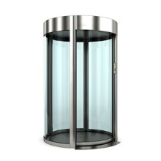

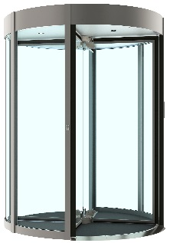

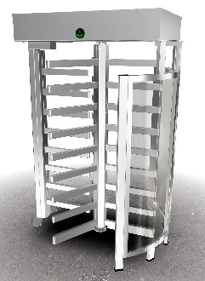

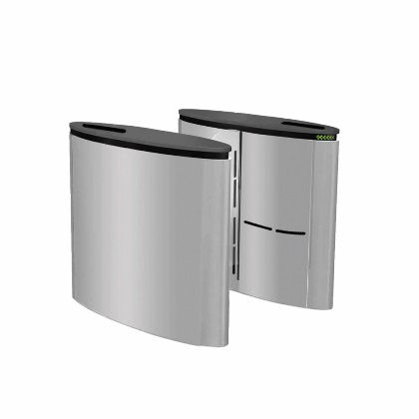

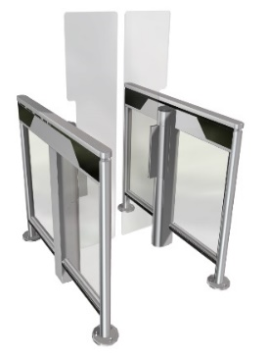


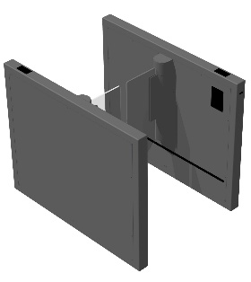
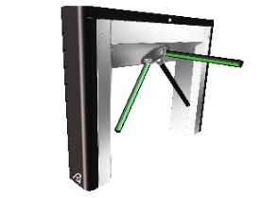

Pedestrian Products
Tripod Turnstile Swing Gate |  | Slide Speedgate | Full Height Turnstile | Revolving Security Door | Security Door
Elegant Design
Single presence detection(anti-tailgating)
Round or Square frame
Bullet, vandalism and theft resistant
Several different finishes available (Stainless, painted)
Wide range of options and accessories
Modern Structure
Three of four sectional revolver
Single presence detection(anti-tailgating)
Interior or façade installation
Wide range of options and accessories
Single passage detection
Designed for intensive use
Resistant to vandalism
Custom colors available
Elegant & reliable
Mechanically secured
by crank & Shaft
Finger entrapment safe
12mm tempered glass
Up to 1900mm glass
Fail-Safe without battery
Slim & Elegant
Modular product
Infrared matrix detection
Multiple options
Narrow Cabinet
Modular product
Single detection matrix
Options available
Reliable
Robust
Efficient
Swing Speedgate
Swing Speedgate
Security

